Slide 1
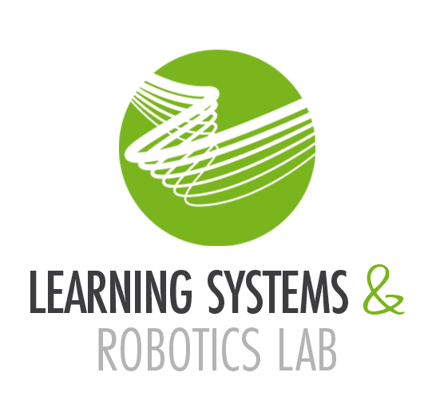

Topic 7: Direct Data-Driven Predictive Control (DDDPC) Machine Learning and Robotics Seminar
July 19th, 2023
Fonseca F., Salotra S., Xie P.
Notes:
Hello everyone.
Our group will be presenting the topic of Direct Data-driven Predictive Control. Our outline …->

Slide 2
Outline
Motivation
Problem Statement
Background
DDDPC Approaches
Implementations and Results
Conclusion
Notes:
… follows the structure of our review paper, starting with and introduction of the motivation and problem statement, followed by a background in the theory of the topic, and finally, a presentation of the approaches and results of the literature. The motivation … ->

Slide 3
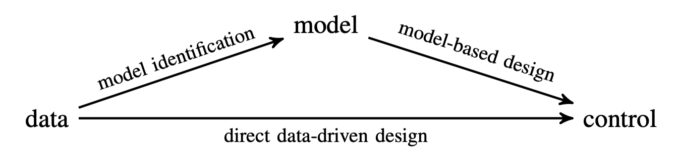
Motivation
Complex systems
Modelling difficulties
Availability of massive amounts of data
Bypass model identification
Figure 1: Direct versus Indirect data-driven methods [1]
Figure 2: [Add Citation at the end]
Notes:
… for this topic lies in the fact that systems are getting more complex, especially in robotics, which leads to an evident difficulty in modelling these systems. This problem and the access to massive data availability have led researchers to explore data-driven methods. Figure 1 shows the outline of the data-driven approach, which can have a model identification step from data, called the indirect method, as seen in the top line, or bypass the identification step altogether, called the direct method. The indirect method is similar to a model-based approach, hence having similar issues. Our review focuses on the direct data-driven approach, specifically how it can be implemented for diverse robotics applications and its advantages and disadvantages. We formulate the direct data-driven predictive control problem … ->

Slide 4
Problem Statement
Direct Data-Driven Predictive Control:
Classical optimal control problem:
Robustness
Safety
Fulfill tasks
Data-driven methods:
Data availability
Data quality
Notes:
… as a classical optimal control problem with some changes. The goal is also to successfully control robotic systems with robustness and safety, guaranteeing the desired tasks. However, direct data-driven predictive control only uses the data to achieve the final goal, which requires us to add to the problem statement the issue present in all data-driven methods, the availability of data, and its quality. These two factors are important for the performance and success of direct data-driven predictive control. We will proceed with a review of behavioral system theory. ->

Slide 5
Background – Behavioral System Theory
Theory by Jan C. Willems
Behavior of dynamic systems:
Set of possible time trajectories
Non-parametric description
Fundamental lemma:
Representation of Linear Time-Invariant (LTI)
Image of a Hankel matrix from data
Notes:
Proposed by Jan C. Willems, it is the backbone of direct data-driven methods. Its approach consists of analyzing a dynamical system based on its behavior, which is the set of time trajectories declared possible by the model of the system, which leads to the possibility of dealing with systems with a “black-box” perspective using non-parametric descriptions. One of the significant results from this theory, the fundamental lemma, provides conditions for a non-parametric representation of Linear Time Invariant systems using the image of a Hankel matrix constructed from raw time series data. Another background theory relevant is … ->

Slide 6
Background – Model Predictive Control
Model of the system needed
Predict system behavior from the model
Robustness and quality of control depend on the model
Notes:
... Model Predictive Control. Contrary to data-driven methods, model predictive control requires knowledge of the model of the system. The control strategy is based on predicting the system’s behavior from the model and the quality of the control performance depends on the robustness and quality of the model. As mentioned, the main problem is the fact that model predictive control requires system identification, which sometimes is infeasible or requires a expert knowledge. We will proceed to the foundations of data-driven control, … ->

Slide 7
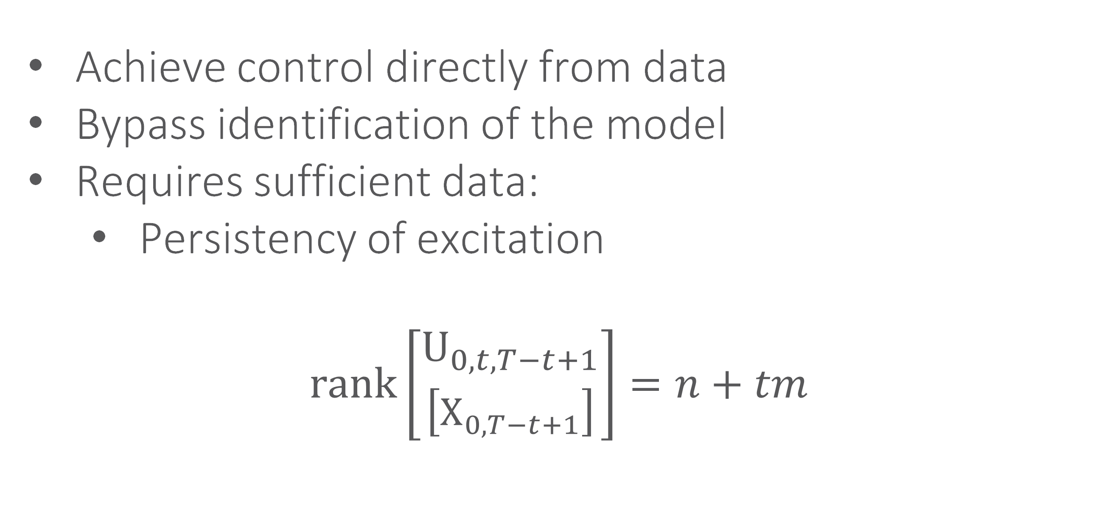
Background – Direct Data-Driven Control
Achieve control directly from data
Bypass identification of the model
Requires sufficient data:
Persistency of excitation
$$\text{rank}\left[\begin{aligned}{\text{U}}_{0,t,T−t+1} \\ \left[{\text{X}}_{0,T−t+1}\right]\end{aligned}\right]=n+tm$$
Notes:
… where we want to achieve control of a system directly from data and bypass the identification step of the model. To do this, it is necessary to have data containing sufficient information, which is called the persistent excitation. We can see the expression where the matrix of an input sequence is persistently exciting of order t if the rank is n + tm, with n as the state dimension and m as the input dimension. U represents input, and X is the system's state.

Slide 8
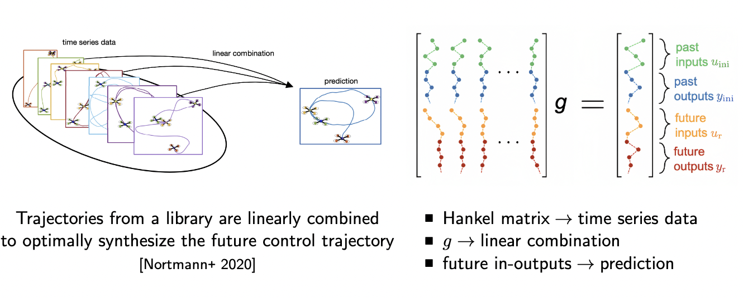
Background – Direct Data-Driven Control - 2
Trajectories from a library are linearly combined to optimally synthesize the future control trajectory
Figure 2: Illustration of linear combination [1]
Notes:
A system's trajectory (u,x) can be combined linearly to optimize the future control trajectory. Figure 2 shows a visual representation of this concept where a linear combination of previous time series data is used to predict and control the trajectory from drone.

Slide 9
Background – Direct Data-Driven Control - 3
Hankel matrix → time series data g → linear combination future in-outputs → prediction
Figure 3: Illustration of the DDDPC formulation [1]
Notes:
Figure 3 visualizes this concept mathematically, where the system's input/output trajectory can be represented as a linear combination of the collected input/output data. The presented result is known as the fundamental lemma of behavioral system theory, … ->

Slide 10
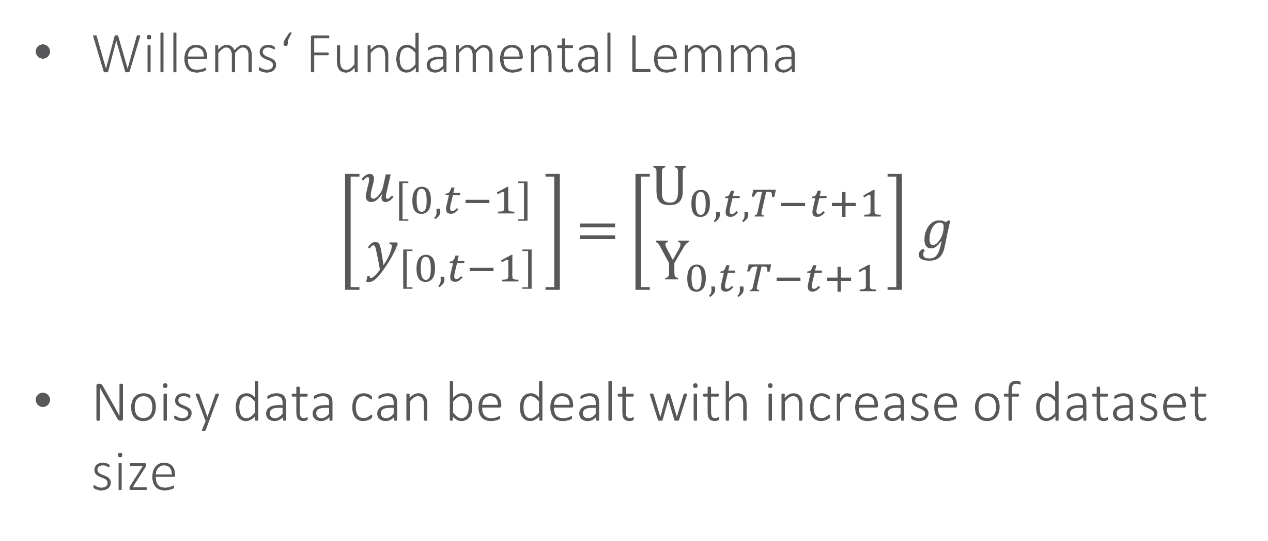
Background – Direct Data-Driven Control - 4
Willems‘ Fundamental Lemma
$$\left[\begin{aligned}u_{\left[0,t−1\right] } \\ y_{\left[0,t−1\right]}\end{aligned}\right]\text{=}\left[\begin{aligned}{\text{U}}_{0,t,T−t+1} \\ {\text{Y}}_{0,t,T−t+1}\end{aligned}\right]g$$
Noisy data can be dealt with increase of dataset size
Notes:
… which was developed by Willems. In this equation, u and y represent the input/output data of the system, and U and Y are the Hankel matrices of the time series data, which can be linearly combined by g to predict the next state. One common issue when dealing with data-driven methods is noisy data which usually leads to problems in control performance. The most common way to address this issue is by increasing the dataset size, leading to the errors created by the noise trend to 0. We will now discuss linearization, the first approach found in the literature. ->

Slide 11
DDDPC Approaches – Linearization
Linearization simplifies the control design of nonlinear systems
Feedback Linearization:
Transform a nonlinear system into a linear system through state feedback
Control using linear control techniques
Singular Input Singular Output nonlinear systems
Notes:
Linearization is a common and popular method used in control theory, which consists using mathematical tools to simplify the control design of nonlinear complex systems. The first approach seen in the context of direct data-driven predictive control is feedback linearization. Feedback linearization focuses on transforming the nonlinear system into a linear one through state feedback and then using linear control techniques. In the literature, this approach is highly utilized in Singular Input Singular Output nonlinear systems. A common thread across papers focused on feedback linearization is that the direct data-driven methods showed significant performance improvement for highly complex systems and hard-to-model dynamics when compared to model-based approaches. The second approach … ->

Slide 12
DDDPC Approaches – Linearization - 2
Koopman Operators:
Linear representation of the dynamics in a high-dimensional function space
Notes:
… consists of using Koopman operators, whic allows for the linear representation of a nonlinear system in a high-dimensional function space. This method showed benefits in the design and analysis of the control system due to the significant simplification offered in the process. We will now review learning-based approaches. ->

Slide 13
DDDPC Approaches - Learning
Neural Networks (NN) mimic the behavior of the system
Notes:
Neural Networks allow the replacement of the traditional model description of a system by mimicking the system’s behavior.
The first approach seen in literature incorporating neural networks was for motion control without robot manipulation where a zeroing neural network is used to control motion only from data, only needing feedback on the end-effector’s position.
The second approach included robot-manipulation, by including an added task of grasping an object. To deal with this, videos of humans was used as data for the controller.
A third approach … ->

Slide 14
DDDPC Approaches - Learning
Neural Networks (NN) mimic the behavior of the system
Important:
Setup of the NNs is crucial to understand if this a DDDPC method !
Notes:
Neural Networks allow the replacement of the traditional model description of a system by mimicking the system’s behavior.
The first approach seen in literature incorporating neural networks was for motion control without robot manipulation where a zeroing neural network is used to control motion only from data, only needing feedback on the end-effector’s position.
The second approach included robot-manipulation, by including an added task of grasping an object. To deal with this, videos of humans was used as data for the controller.
A third approach … ->

Slide 15
DDDPC Approaches - Learning
Neural Networks (NN) mimic the behavior of the system
Important:
Setup of the NNs is crucial to understand if this a DDDPC method !
Example:
NN trained with I/O dataset from aerial robot controlled by PID
Notes:
Neural Networks allow the replacement of the traditional model description of a system by mimicking the system’s behavior.
The first approach seen in literature incorporating neural networks was for motion control without robot manipulation where a zeroing neural network is used to control motion only from data, only needing feedback on the end-effector’s position.
The second approach included robot-manipulation, by including an added task of grasping an object. To deal with this, videos of humans was used as data for the controller.
A third approach … ->

Slide 16
DDDPC Approaches - Learning
Neural Networks (NN) mimic the behavior of the system
Important:
Setup of the NNs is crucial to understand if this a DDDPC method !
Example:
NN trained with I/O dataset from aerial robot controlled by PID
But weights do not get updated during control
Notes:
Neural Networks allow the replacement of the traditional model description of a system by mimicking the system’s behavior.
The first approach seen in literature incorporating neural networks was for motion control without robot manipulation where a zeroing neural network is used to control motion only from data, only needing feedback on the end-effector’s position.
The second approach included robot-manipulation, by including an added task of grasping an object. To deal with this, videos of humans was used as data for the controller.
A third approach … ->

Slide 17


DDDPC Approaches - Learning
Neural Networks (NN) mimic the behavior of the system
Important:
Setup of the NNs is crucial to understand if this a DDDPC method !
Example:
NN trained with I/O dataset from aerial robot controlled by PID
But weights do not get updated during control DDDPC method
Notes:
Neural Networks allow the replacement of the traditional model description of a system by mimicking the system’s behavior.
The first approach seen in literature incorporating neural networks was for motion control without robot manipulation where a zeroing neural network is used to control motion only from data, only needing feedback on the end-effector’s position.
The second approach included robot-manipulation, by including an added task of grasping an object. To deal with this, videos of humans was used as data for the controller.
A third approach … ->

Slide 18
DDDPC Approaches - Learning - 2
Motion Control without Robot-Manipulation:
Two Dicrete Zeroing Neural Network (DZNN) control the motion of robot
First DZNN force error of position of end-effector to zero
Second DZNN force error of velocity of end-effector to zero
Motion Control with Robot-Manipulation:
Videos of humans grasping used as data
Notes:
Neural Networks allow the replacement of the traditional model description of a system by mimicking the system’s behavior.
The first approach seen in literature incorporating neural networks was for motion control without robot manipulation where a zeroing neural network is used to control motion only from data, only needing feedback on the end-effector’s position.
The second approach included robot-manipulation, by including an added task of grasping an object. To deal with this, videos of humans was used as data for the controller.
A third approach … ->

Slide 19
DDDPC Approaches - Learning - 3
Walking assistance control:
Data-driven reinforcement learning
Online adaptation with actor-critic neural network
Notes:
… was done for walking assistance control, where data-driven reinforcement learning was used since the controller needs to adapt to different patients with different individual disturbances. To deal with this, an online adaptation technique was implemented through an actor-critic neural network which consists of the actor-network, which approximates the controller, and the critic network, which estimates the online parameters for a proportional integral algorithm. This is a direct data-driven predictive control approach since the neural network weights are updated during control. We will now review how persistent excitation is dealt with in the literature. ->

Slide 20
DDDPC Approaches - Persistent Excitation
Figure 3: Illustration of the DDDPC formulation [1]
Data must be persistently excited to find g to replace models​
Notes:
…In the background, we have discussed the importance of persistent excitation, which is needed to replace models. accroding to the equation before we should make sure persistent exictation, in another word, the full rank of the input matrix so that we can calculate the g by the inverse matrix.

Slide 21
DDDPC Approaches - Persistent Excitation - 2
Introduce noise to guarantee excitation
Leads to degrade control performance
Online adaptation
Singular Value Decomposition to check persistent excitation of the input and whether to update the data in real-time
Notes:
And here are two methods used to solve the problem when persistent excitation is lack. One way is to inject the noise to gurarante the excitation of all input matrix. However it may lead to degrade control performance due to the noise. An onther way was mentioned by the scholars in tum. They try to filter the input data without persistent excitation firstly and use the pervious data to replace the them in the update. However the input data are pullated by the measurement noise which make finding the target input data more difficult. So they use Singular Value Decomposition method and select approprate threshods to find them. And finial the performance of the direct data-driven control improved a lot.
->

Slide 22
Implementations and Results
Two types of implementations:
Simulation
Practical implementation
Notes:
We will now review the implementations and results of the approaches mentioned so far. We considered two types of results, simulation, and practical implementation. We start with the results of the … ->

Slide 23
Implementations and Results – Linearization
Simulation:
Robust control invariant (RCI) set for double integrator system
Hammerstein model with L2 norm
Non-minimum phase system
Notes:
… linearization approach.
In one simulation, a robust control invariant set for a double integrator system is studied for both a direct data-driven predictive control and a model-based control, and it is concluded that the RCI is more extensive for the direct data-driven method.
A second simulation focused on a Hammerstein model using the L2 norm and showed excellent control performance, although it was assumed a system with no noise.
Similarly, the direct data-driven predictive control showed better control performance for a non-minimum phase system than the model-based approaches.
Another … ->

Slide 24
Implementations and Results – Linearization - 2
Simulation:
Unbalanced disk state-feedback controller
Snake robot
Inverted pendulum
Practical implementation:
Linear motor control
Notes:
… comparison of controllers was made for an unbalanced disk state-feedback controller, and it was shown that the direct data-driven controller could successfully control the system while the linear time-invariant controller diverged.
Another paper simulated a snake robot with a complex nonlinear system and proved that the direct data-driven controller is easier to design for better performance than the model-based methods.
An inverted pendulum simulation was used to show that the noise cannot be too high in the data, or the system becomes uncontrollable.
The only relevant practical implementation focused on linearization was for linear motor control, where real-time effective control was achieved with better performance than model-based controllers. We will now review the results of the learning-based approaches. ->

Slide 25
Implementations and Results - Learning
Only Practical Implementation:
Autonomous grasping with a soft robotic hand
Notes:
Both a simulation and a practical implementation were achieved for the three approaches. Motion control was implemented for continuum robots to track a circular path and could certify the use of data-driven motion control algorithms for real-world problems in robotics.
The second result was using a soft robotic hand to do autonomous grasping, where a neural network is used as a classifier (trained with human videos) to help the data-driven controller grasp items on a table.
The last result for the approach of walking assistance control was of a lower limb exoskeleton for hemiplegic patients. The simulation showed convergence in 6 seconds of learning with good tracking performance. The practical experiment showed convergence after 15 seconds showing the success of the direct data-driven predictive control learning-based approach.
We will now review the results of the excitation problem
->

Slide 26
Implementations and Results – Learning - 2
Simulation and Practical Implementation:
Continuum robot track of a circular path
Lower limp exoskeleton
Notes:
Both a simulation and a practical implementation were achieved for the three approaches. Motion control was implemented for continuum robots to track a circular path and could certify the use of data-driven motion control algorithms for real-world problems in robotics.
The second result was using a soft robotic hand to do autonomous grasping, where a neural network is used as a classifier (trained with human videos) to help the data-driven controller grasp items on a table.
The last result for the approach of walking assistance control was of a lower limb exoskeleton for hemiplegic patients. The simulation showed convergence in 6 seconds of learning with good tracking performance. The practical experiment showed convergence after 15 seconds showing the success of the direct data-driven predictive control learning-based approach.
We will now review the results of the excitation problem
->

Slide 27
Implementations and Results - Excitation
Simulation:
Effect of persistent excitation on 3 controllers
Numerical analysis with singular value decomposition (SVD) methods to process input
Notes:
In the first simulation, the importance of persistence excitation was studied through numerical analysis simulations on three controllers, where it was concluded that the higher the persistency of excitation, the better the data-driven control performance.
And in second simulation, a numerical analysis was made To deal with noise by using the singular value decomposition method to process the input and decide whether or not to update the data. And the final results show that replacing the data which is not persistent excited with the pervious excited data improve the whole performance a lot.
->

Slide 28
Conclusion
DDDPC shows improvements for several systems
Data reliability and processing needs improvement
Computational complexity is still an issue
The research in DDDPC is currently in an early stage -> Future see more real-world examples in robotics
DDDPC a promising approach for future robotic control approaches
Notes:
To conclude, direct data-driven predictive control has been used to develop simulations and practical examples of how to bypass the model of a system and showed improvements for several systems compared to model-based methods.
Nonetheless, results also showed that dealing with noisy data and ensuring its reliability is a problem that still needs to be resolved. Similarly, the need to meet persistent excitation leads to the requirements of massive amounts of data, which in turn means high demand for computational power.
We have shown that direct data-driven predictive control is a promising approach to deal with the complexity present in the field of robotics.
Thank you very much.

Slide 29
References
[1] Markovsky, Ivan, Linbin Huang, and Florian Dörfler. "Data-driven control based on the behavioral approach: From theory to applications in power systems." IEEE Control Syst. (2022).

